Slide 1

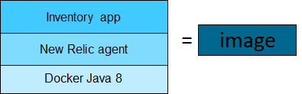
Build a container
Step 1: Use gradle to build the inventory app jar file in your local environment
Step 2: Build a docker image locally with java 8, New Relic agent, and the inventory app
Step 3: Tag the image to tell Docker where to push it
gradlew build
:
Inventoryapp.jar
image
Notes:
Can be created from IBM images or images that you create
Images can be deployed as a single container or as scalable container groups
In the lab exercise, you will
Step1: Build a jar file for the inventory microservice with the provided source code in your local environment
Step 2: Then you will build a docker image locally that contains the inventory microservice. The inventory jar file will be added to a standard Docker java base image, and the New Relic monitoring agent will be added as well
Step 3: Tag your image By default, Docker assumes that the image is pushed to DockerHub. So to be able to push to bluemix, docker push has to be told which host to send the image to; (The tag itself represent an alias of the image, if you do docker images, you can see that the UUID is still the same....) The tag has the format of "registry-host:port/repo-name/imagename:tag"; for Bmx, the port is the default and the registry name is called namespace.

Slide 2








Deploy the container to Bluemix
Step 4: Push the image to your Bluemix registry
registry.ng.bluemix.net/${cf ic namespace get} /inventoryservice-${SUFFIX}
(i.e. (i.e. registry.ng.bluemix.net/pfgeiger/inventoryserivce-pgeiger)
Step 5: Create and run the container group in Bluemix
image
image
image
image
public
corporate data center
container
Secure Gateway
Client
image
Notes:
Step 4: Upload or ‘push’ the image to your Bluemix repository
Step 5: Run the container group

Slide 3
End to end flow
1.Build
Inventory
app
gradlew build
:
Inventoryapp.jar
2.Build
Docker
image
3.Tag
image
image
public
corporate data center
container
Secure Gateway
Client
image
image
image
image
image
4.Push to
Bluemix
registry
5.Create
and
run

Slide 4
Create the container group in Bluemx
-p: Port
-m memory limit for the container in MB
--min: minimum number of instances in group
--desired: desired number of instances
--auto: Enable auto recovery
--name: The name for the group
-e: set environment variable. Each environment variable is a key value pair
-n: The host name
-d: The domain name for the group. The host and the domain combined form the full public route URL
The image to include in each container in the group is the last
cf ic group create -p 8080 -m 256 --min 1 --desired 1 \
--auto --name micro-inventory-group-${SUFFIX} \
-e "spring.datasource.url=jdbc:mysql://${ipaddr}:3306/inventorydb" \
-e "spring.datasource.username=dbuser" \
-e "spring.datasource.password=Pass4dbUs3R" \
-n inventoryservice-${SUFFIX} -d mybluemix.net \
registry.ng.bluemix.net/$(cf ic namespace get)/inventoryservice-${SUFFIX}
Notes:
This is the command that you will use to create and run the container group in Bluemix. The tags are explained on the right. Of course you probably wouldn’t want to be typing this long command every time you deploy your environment, but would use Opentool Chain or an automated process to create the container group.
When auto-recovery is enabled for a container group, IBM Containers checks the health of each instance with an HTTP request to the port that is assigned. If no TCP response is received from a container instance in two subsequent 90-second intervals, the instance is removed and replaced with a new instance. For more information about the health check, see the --http_monitor_enabled option. If the health check does not receive a TCP response from a container instance in two subsequent 90-second intervals, the instance is removed and replaced with a new instance. No action is taken if the container responds. This process is repeated continuously. If during a 30-minute window, the total number of different containers that were members of the group, equals, or exceeds three times the maximum size of the group, automatic recovery is disabled permanently for the container group. To enable automatic recovery again, you must re-create the container group.

Slide 5
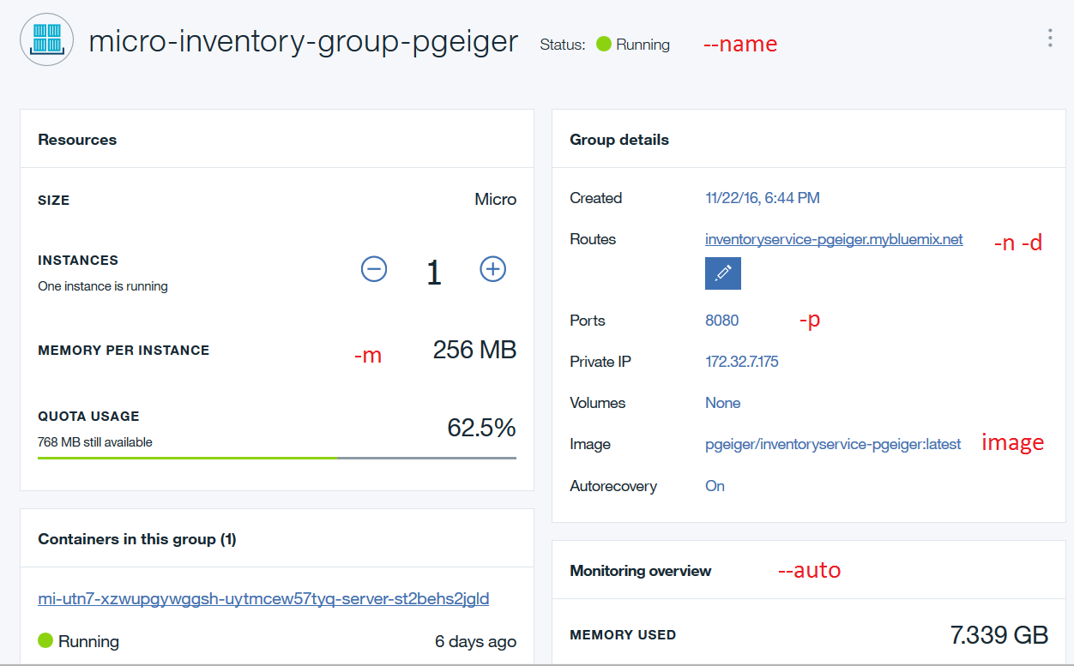
Container Group in Bluemix

